Slide 1

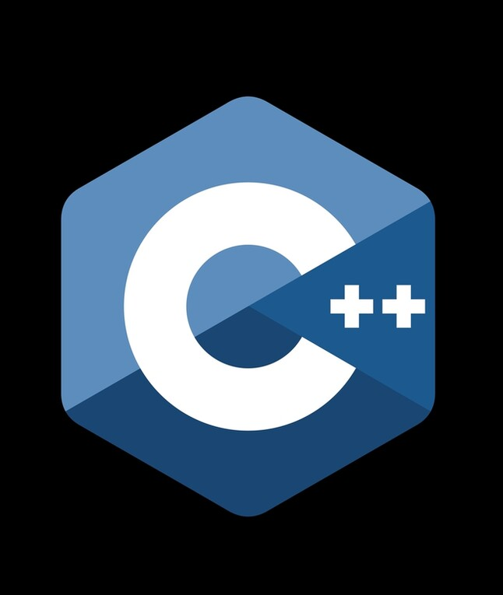
Object oriented program project
Group 13

Slide 2

Contents
Basics of oops
Constructor
Destructor
Class
Uml
Inline function
Friend function
Operators overloading
Abstract class
Pure virtual function

Slide 3

Our Team
Aviral Srivastava (20BCE11027)
Muskan Jain (20BCE10910)
Ansh Srivastava (20BCE10572)

Slide 4

Basics of oops
Object-oriented programming has four basic concepts: encapsulation, abstraction, inheritance and polymorphism. Even if these concepts seem incredibly complex, understanding the general framework of how they work will help you understand the basics of a computer program

Slide 5
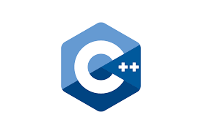
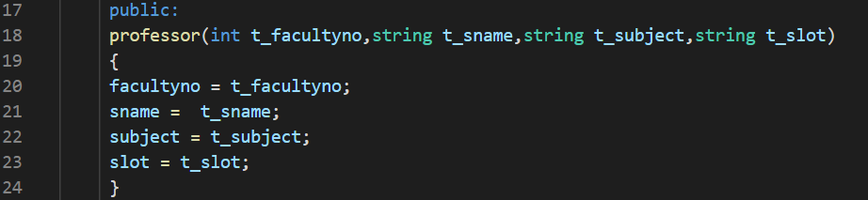
Constructor
In class-based object-oriented programming, a constructor is a special type of subroutine called to create an object. It prepares the new object for use, often accepting arguments that the constructor uses to set required member variables

Slide 6

Destructor
In object-oriented programming, a destructor is a method which is invoked mechanically just before the memory of the object is released. It can happen when its lifetime is bound to scope and the execution leaves the scope, when it is embedded in another object whose lifetime ends, or when it was allocated dynamically and is released explicitly.

Slide 7
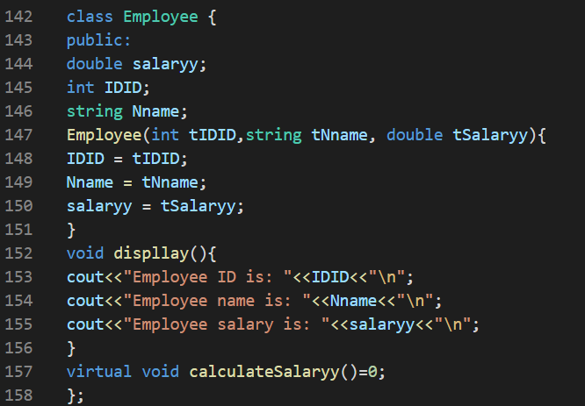
Class
In object-oriented programming a class is a blueprint for creating objects (a particular data structure), providing initial values for state (member variables or attributes), and implementations of behaviour (member functions or methods)
The class is a blueprint that defines a nature of a future object.

Slide 8

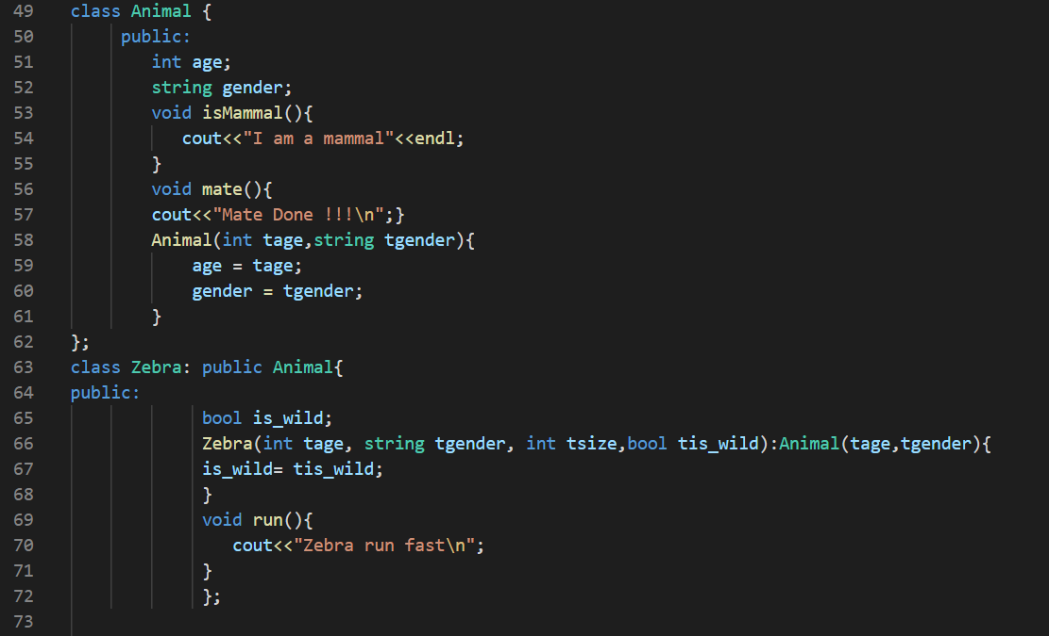
Uml
UML, Unified Modelling Language, is a standard notation for the modelling of real-world objects as a first step in developing an object oriented program. It describes one consistent language for specifying, visualizing, constructing and documenting the artifacts of software systems

Slide 9

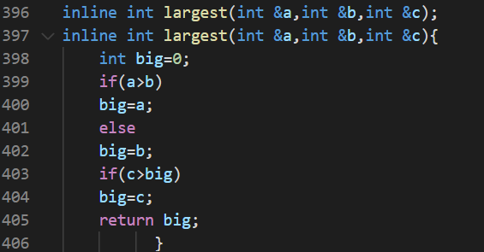
Inline function
C++ inline function is powerful concept that is commonly used with classes. If a function is inline, the compiler places a copy of the code of that function at each point where the function is called at compile time. ... The compiler can ignore the inline qualifier in case defined function is more than a line.

Slide 10
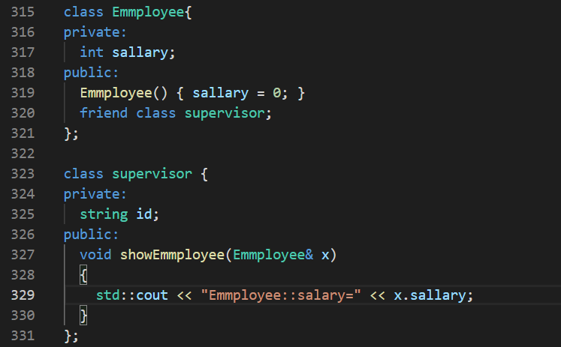
Friend function
In object-oriented programming, a friend function, that is a "friend" of a given class, is a function that is given the same access as methods to private and protected data. A friend function is declared by the class that is granting access, so friend functions are part of the class interface, like methods.

Slide 11
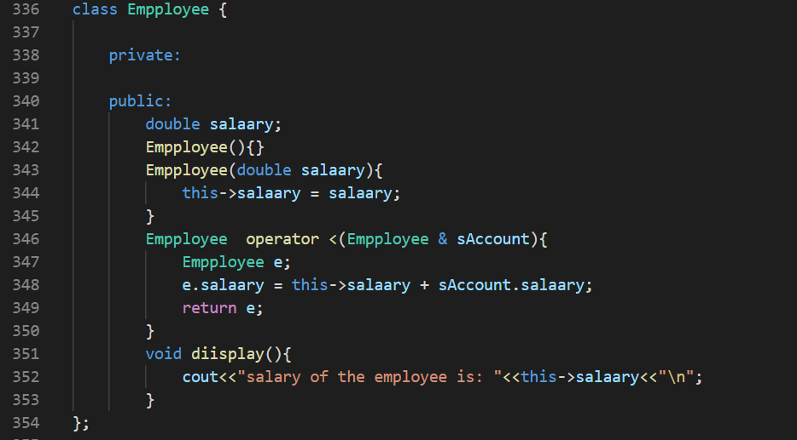
Operator overloading
It is polymorphism in which an operator is overloaded to give user defined meaning to it. Overloaded operator is used to perform operation on user-defined data type. For example '+' operator can be overloaded to perform addition on various data types, like for Integer, String(concatenation) etc.

Slide 12

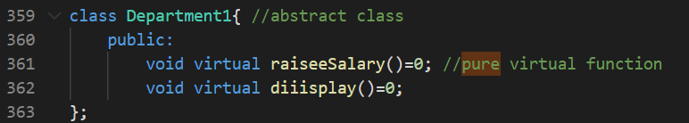
Abstract class
Abstract classes and methods are when the parent class has a named method, but need its child class(es) to fill out the tasks. An abstract class is a class that contains at least one abstract method. An abstract method is a method that is declared, but not implemented in the code

Slide 13

Pure virtual function
A pure virtual function (or abstract function) in C++ is a virtual function for which we can have implementation, But we must override that function in the derived class, otherwise the derived class will also become abstract class

Slide 14

Acknowledgement
I would like to express my special thanks of gratitude to my teacher Dr. Harshavardhanan who gave me the golden opportunity to do this wonderful project on the topic object oriented program(Employee management), which also helped me in doing a lot of Research and I came to know about so many new things I am really thankful to them. Secondly i would also like to thank friends who helped me a lot in finalizing this project within the limited time frame.

Slide 15

Thank you

